Slide 1
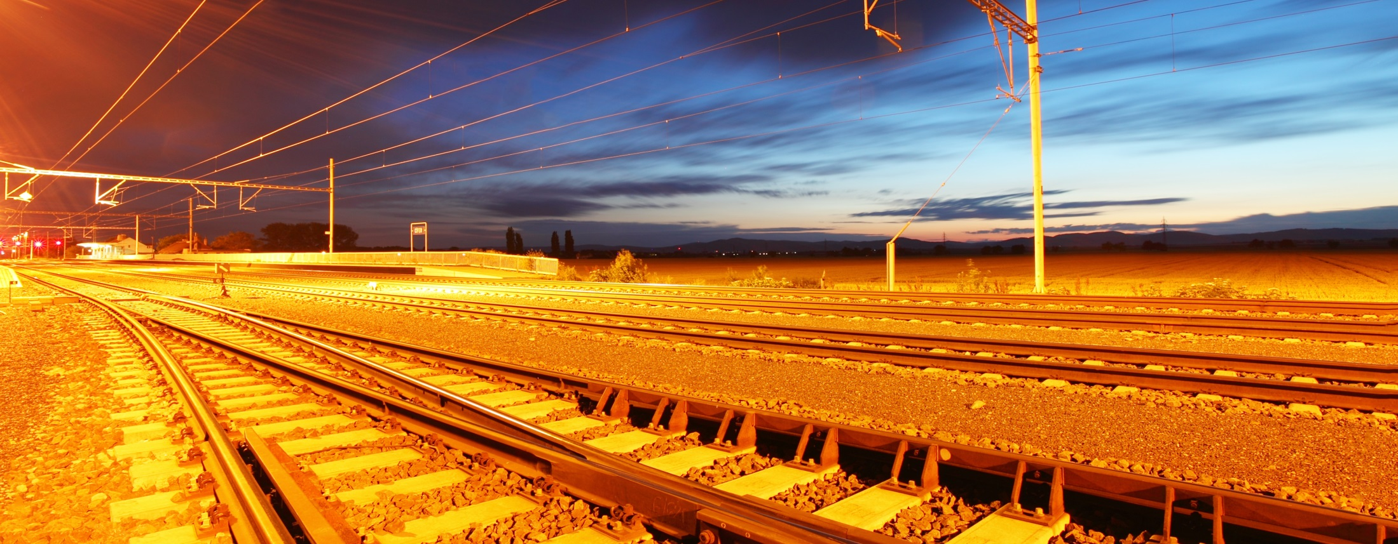
| BLT RHEDA 2000® & Getrac® A3
PCM RAIL.ONE AG
Dipl.-Ing. (FH) Wojciech Nawrat, PCM RAIL.ONE AG
Dipl.-Ing. Arnold Pieringer, PCM RAIL.ONE AG

Slide 2


Topics
BLT RHEDA 2000®
BLT Getrac ® A3

Slide 3
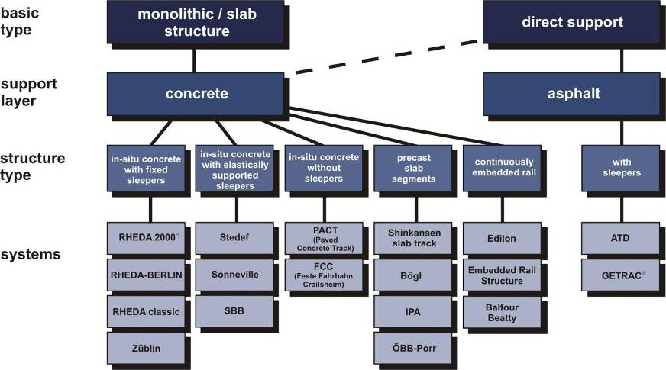
Ballastless tracks - Survey of existing ballastless track systems

Slide 4










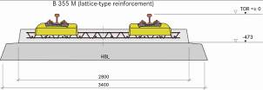




The Rheda Development Stages

Slide 5
RHEDA 2000®
System Overview

Slide 6
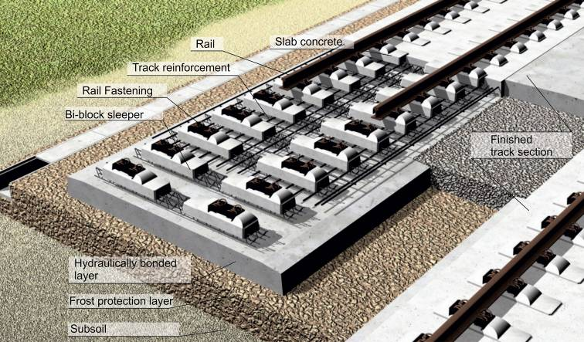
The RHEDA 2000® ballastless track system on grade

Slide 7
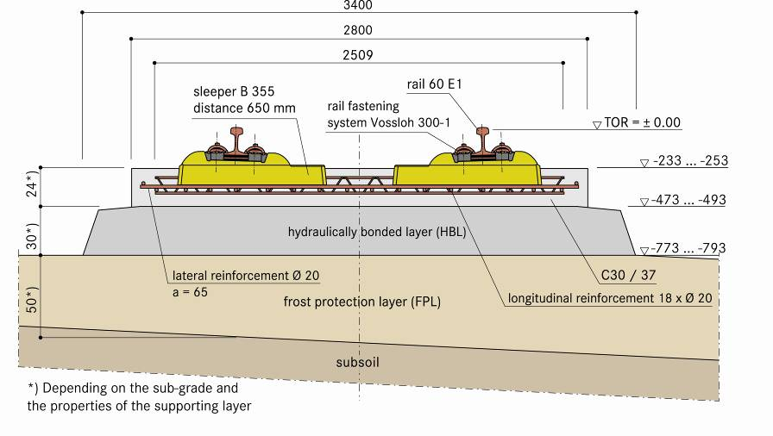
The RHEDA 2000® ballastless track system on grade

Slide 8
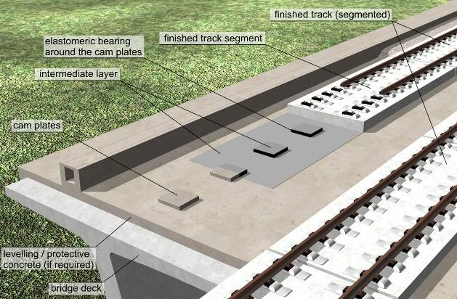
The RHEDA 2000® ballastless track system on bridges

Slide 9
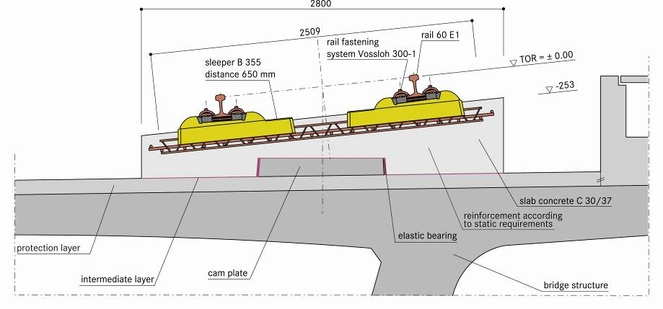
The RHEDA 2000® ballastless track system on bridges

Slide 10
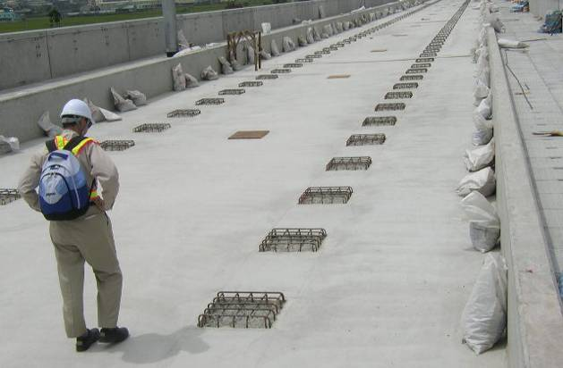
The RHEDA 2000® ballastless track system on bridges (2)

Slide 11
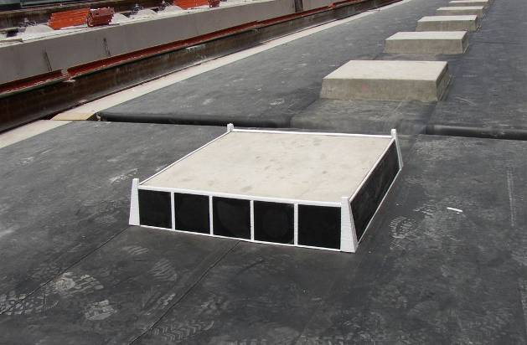
The RHEDA 2000® ballastless track system on bridges (2)

Slide 12
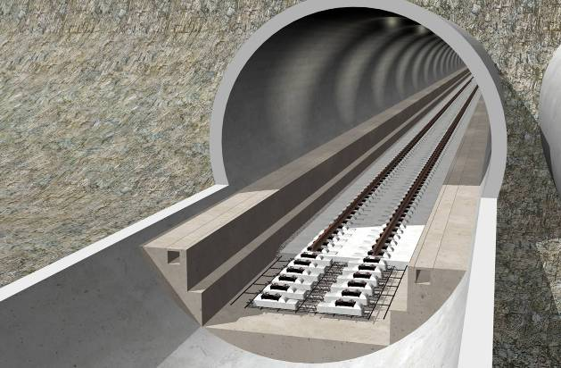
The RHEDA 2000® ballastless track system in tunnels

Slide 13
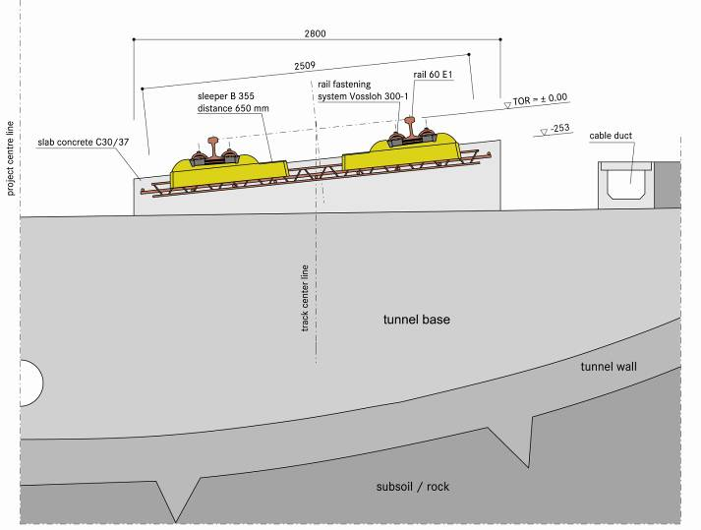
The RHEDA 2000® ballastless track system in tunnels

Slide 14
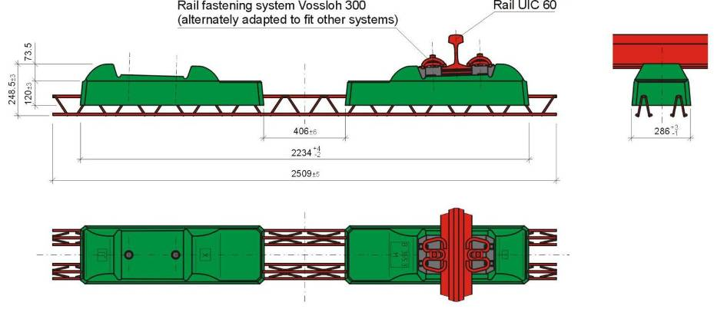
Modified bi-block sleeper B 355.3 W60M

Slide 15
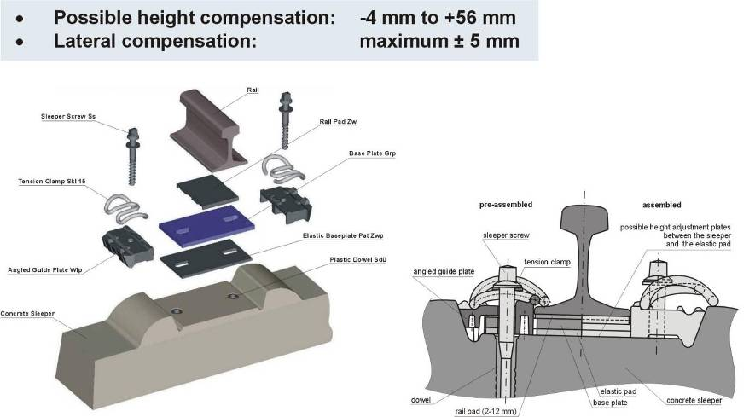
Rail fastening system Vossloh 300-1

Slide 16
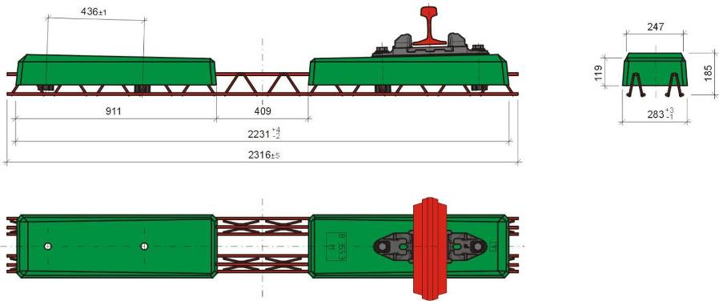
Modified bi-block sleeper B 355.3 P60M

Slide 17
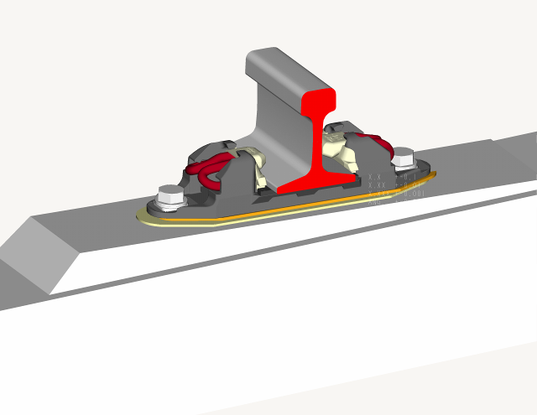
Rail fastening system “Pandrol baseplate”

Slide 18
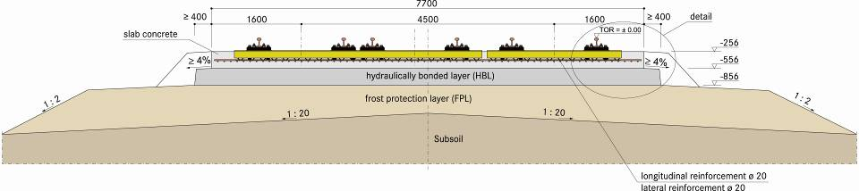
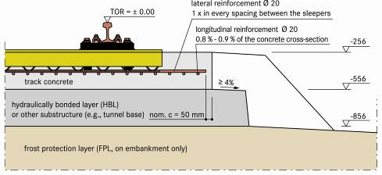
Turnout technology of the RHEDA 2000® ballastless track system

Slide 19
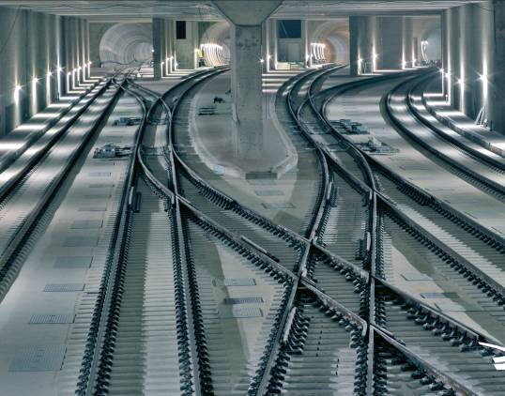
Turnouts installed as part of the RHEDA 2000® ballastless track system, in the Berlin North-South Link

Slide 20
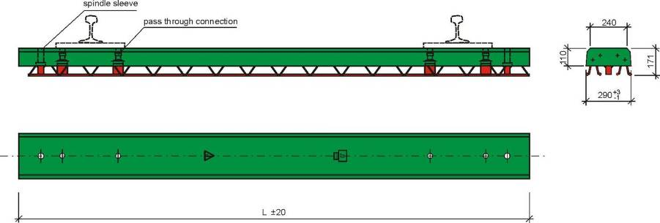
Turnout sleeper for ballastless track system
RHEDA 2000®

Slide 21
Advantages of the RHEDA 2000® system
A maximum of cost effectiveness and reliability by utilisation of concrete sleepers as superior-quality precast concrete building components in the critical area of the rail-seat zone
Great precision of track-geometry parameters by application of precise concrete sleepers
Great adaptability to all types of substructure and models executed, by means of application of cast-in-place concrete for the concrete track-supporting layer
Great reliability as a result of technologically mature concrete engineering of the track-supporting layer for a great diversity of climatic conditions and concrete standards
Flexible, high-performance installation procedures on the basis of simple installation steps that are reproducible for both manual as well as automated procedures
Great added value by local production possibilities

Slide 22
RHEDA 2000®
Installation Process

Slide 23
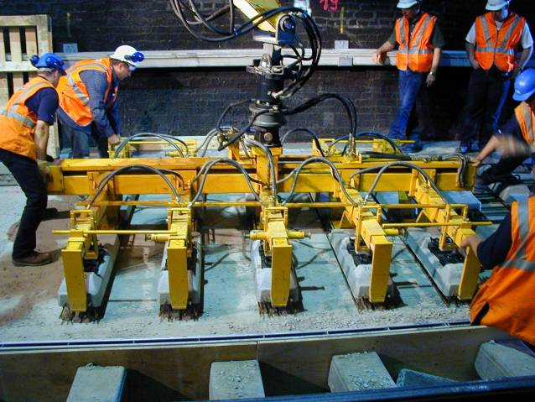
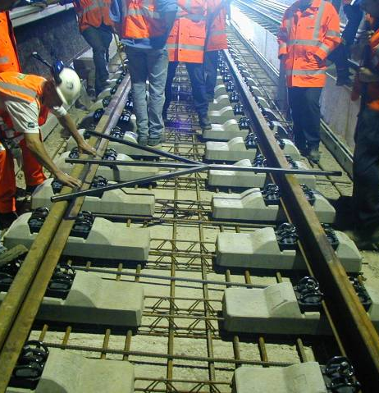
Ballastless tracks
RHEDA 2000®: Positioning of bi-block crossties

Slide 24
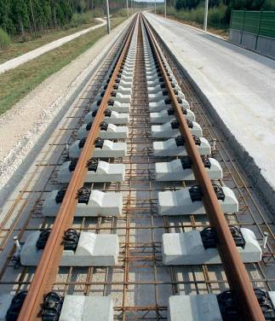
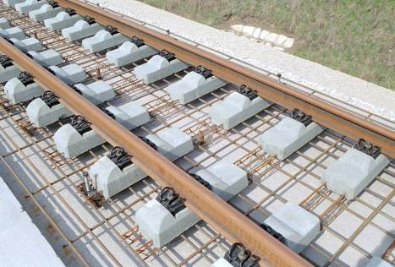
Ballastless tracks
Reinforcement and track pre-assembly of RHEDA 2000®

Slide 25
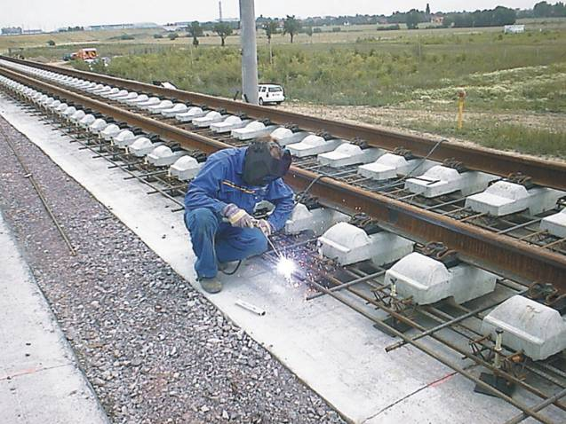
Ballastless tracks
RHEDA 2000®: Earthing Installation

Slide 26
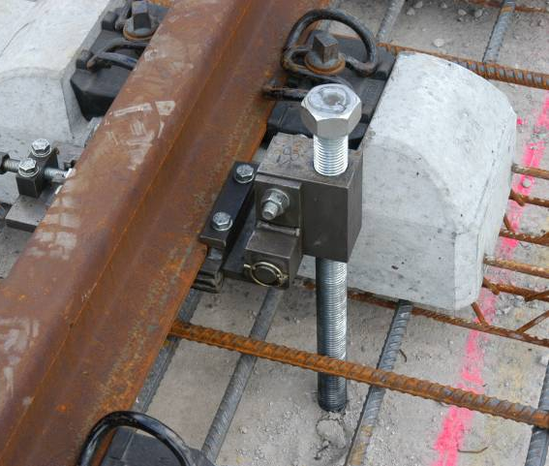
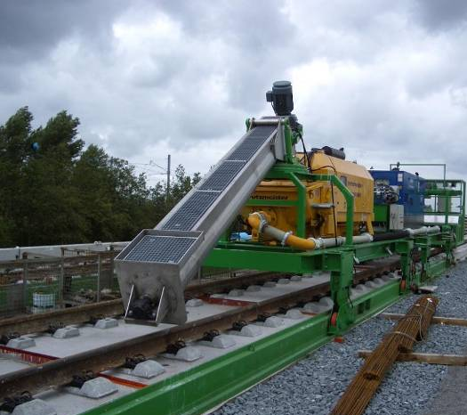
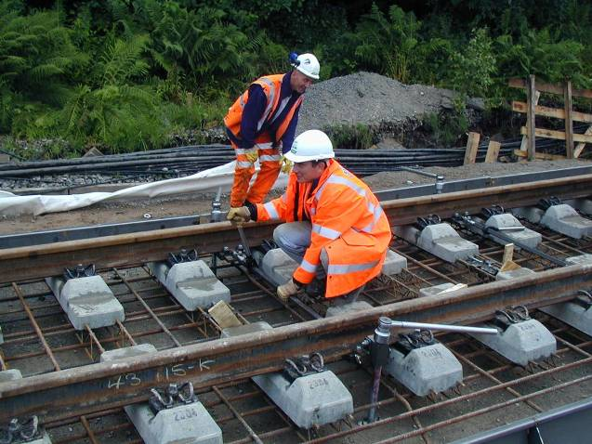
Ballastless tracks
Adjustment of RHEDA 2000® with spindle brackets

Slide 27
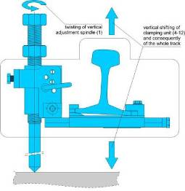
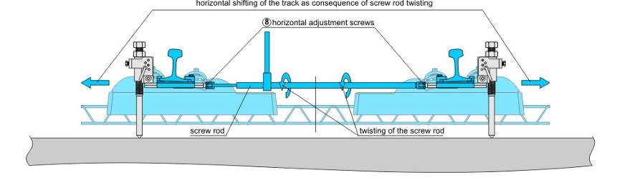
Ballastless tracks
Adjustment of RHEDA 2000® with spindle brackets

Slide 28
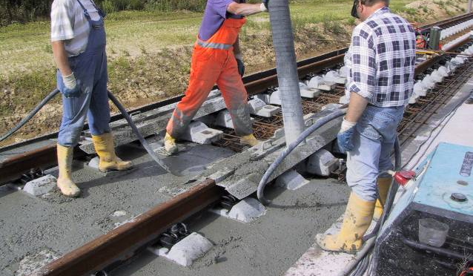
Ballastless tracks
Concreting of RHEDA 2000® track

Slide 29
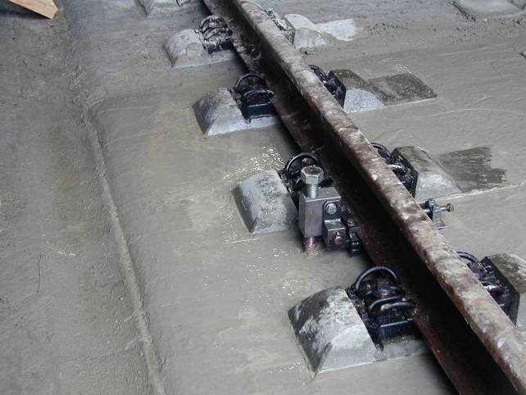
Ballastless tracks
Concreting of RHEDA 2000® track

Slide 30
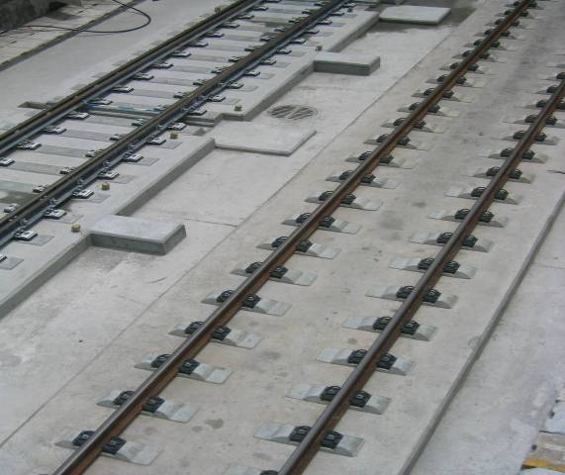
Ballastless tracks
Finished RHEDA 2000® track

Slide 31
RHEDA 2000®
Special solutions

Slide 32
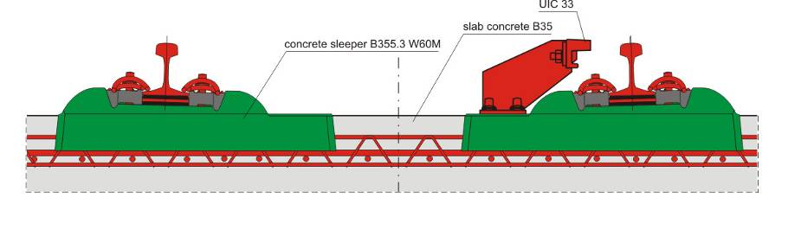
Ballastless tracks
RHEDA 2000® with derailment device

Slide 33
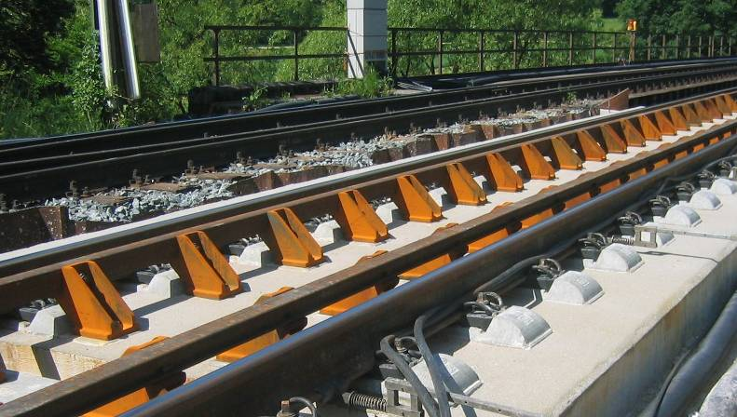
Ballastless tracks
RHEDA 2000® with derailment device

Slide 34
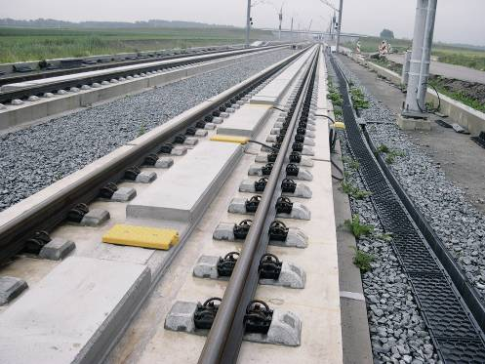
Ballastless tracks
RHEDA 2000® with derailment device (concrete beam solution)

Slide 35
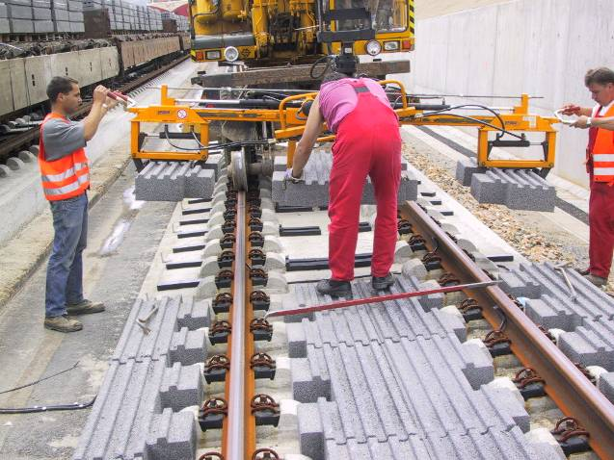
Ballastless tracks
Installation of noise absorption elements

Slide 36
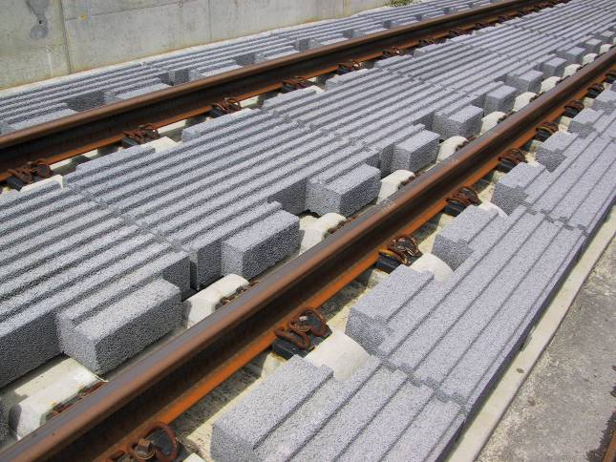
Ballastless tracks
The BETA prefabricated noise absorber

Slide 37
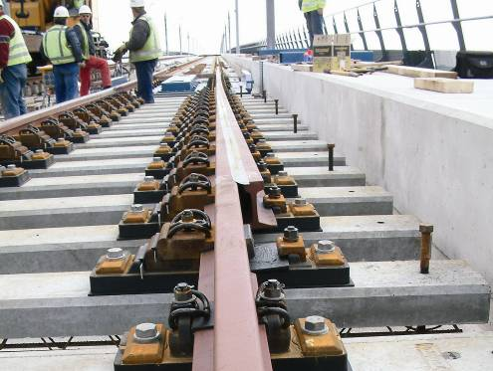
Rail expansion joints with RHEDA 2000®

Slide 38
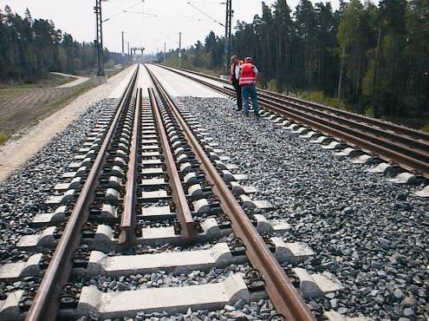
Transitions with RHEDA 2000®

Slide 39
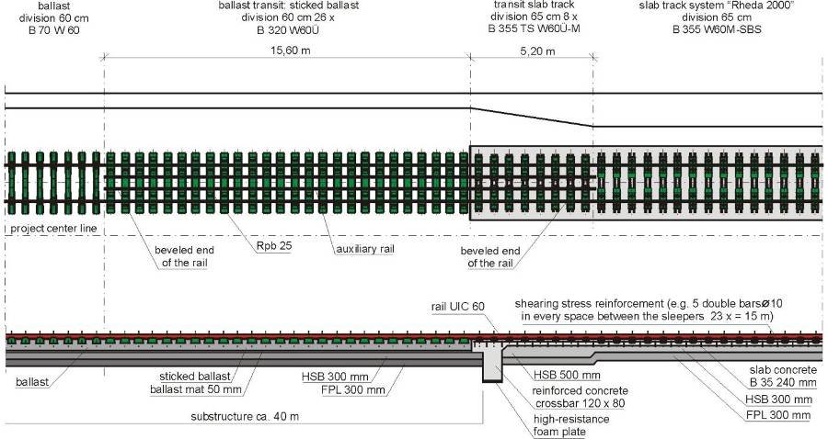
Ballastless tracks
Transition area RHEDA 2000® - ballasted track

Slide 40
RHEDA 2000®
Former applications

Slide 41
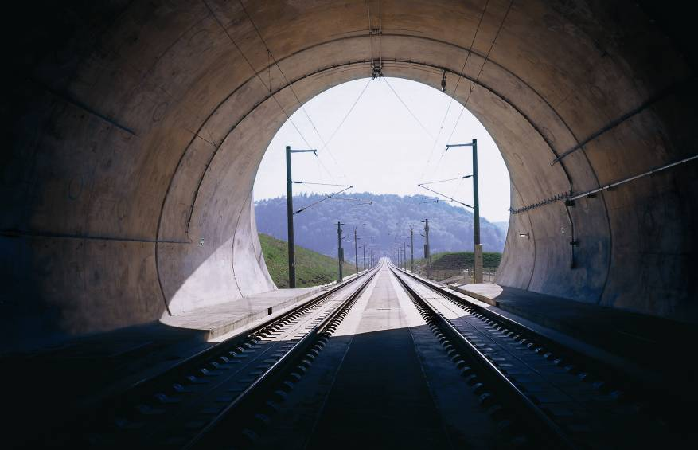
RHEDA 2000® on the line from Nuremberg to Ingolstadt, Germany
Construction: 2004-2005

Slide 42
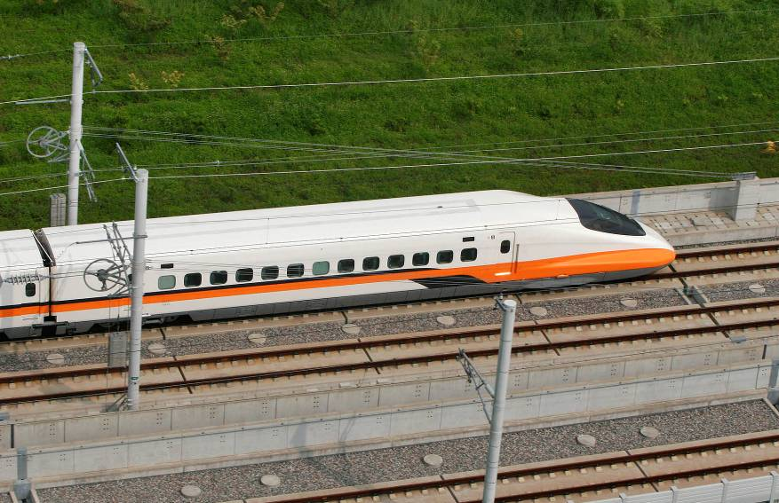
RHEDA 2000® on the Taiwan High Speed Rail Line
Construction: 2003-2006

Slide 43
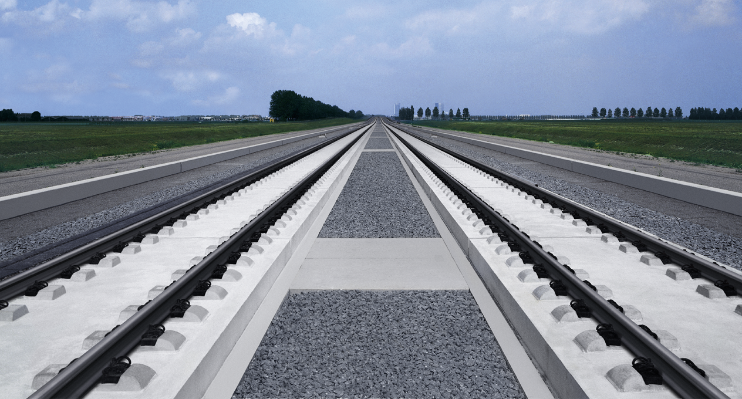
RHEDA 2000® on the high-speed line HSL Zuid in Holland
Construction: 2002-2006

Slide 44
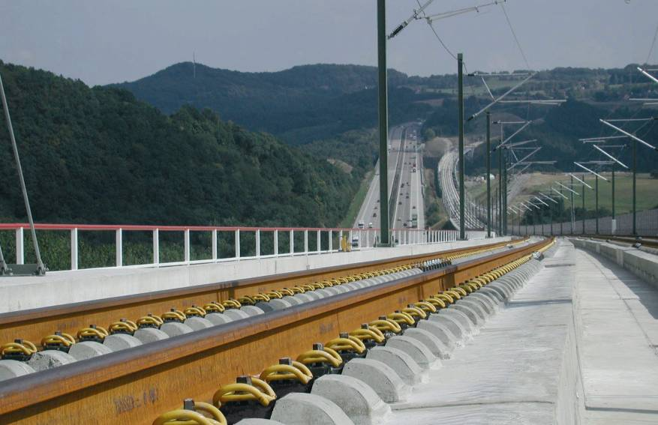
180,000 RHEDA-sleepers for the high-speed line Cologne – Frankfurt
Construction: 1999-2002

Slide 45
Getrac® A3
System Overview

Slide 46
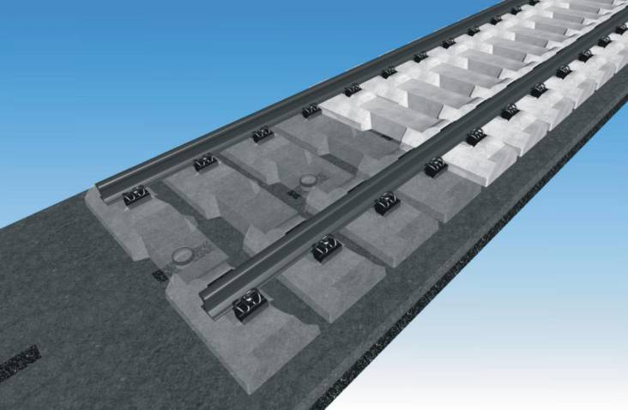
Ballastless track system GETRAC® A3

Slide 47
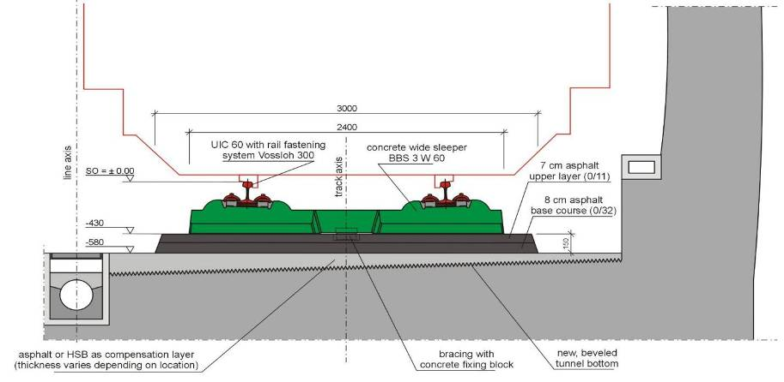
Cross section of GETRAC® A3 in tunnels

Slide 48
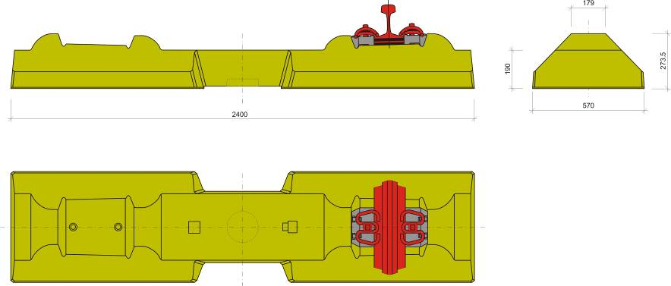
Wide concrete sleeper BBS 3 W 60

Slide 49
Advantages of the GETRAC® A3 system
Technologically mature system with maximal safety and reliability
Fast and low-risk installation as a result of ...
  Fewer steps of work
  High degree of mechanisation
  Application of conventional road-building and track-laying equipment (with conventional track-laying and –alignment techniques)
  Lack of dependency on the weather
Possibility of conversion of existing rail lines without interference with the parallel track
Immediate availability of the track after its installation
Minimal down time and effort in track reconstruction after train accidents

Slide 50
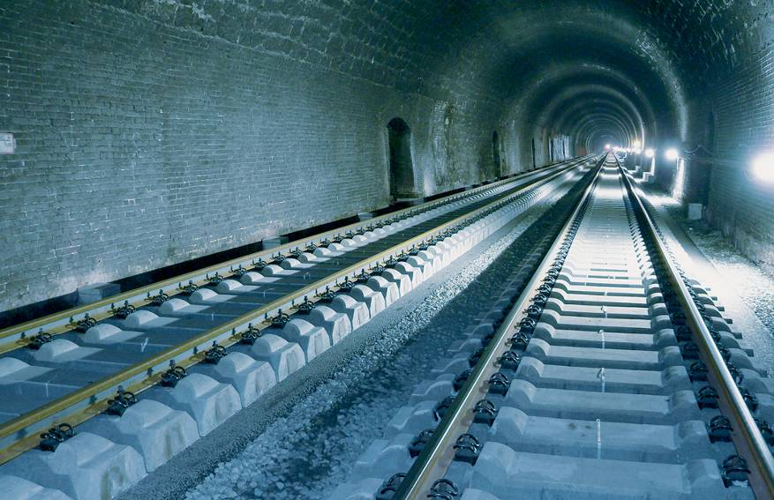
Replacement of the track system with 6.3 km in GETRAC® A3 Brandleite Tunnel (Germany)
Construction: 2005

Slide 51
Contact
HP + 91 9100991209
www.pcmstrescon.com

